Slide 1
MYSQL QUERY EDITOR
BY
ADARSH MISHRA
Padmashri Annasaheb Jadhav Bhartiya Samaj Unnati Mandal’s
B.N.N. COLLEGE
(Arts, Science, Commerce & Self-Funded Course)
BHIWANDI, MAHARASHTRA-421302
2022-2023

Slide 2
Overview
Introduction to Web Application
Goal of the Project
Working of the Project
Frontend Requirement
Backend Requirement
Design Flowchart
Advantages
Conclusion

Slide 3
Introduction
A web application (or web app) is application software that runs in a web browser, unlike software programs that run locally and natively on the operating system (OS) of the device. Web applications are delivered on the World Wide Web to users with an active network connection.
A Browser is an application that is used to browse the internet.
Web application needs authentication. The web application uses a combination of server-side scripts and client-side scripts to present information.
It requires a server to manage requests from the users.

Slide 4
GOAL OF THE PROJECT
“MYSQL QUERY EDITOR” is an Web App based project.
The goal of this project is to create web app which help the user to interact with database.
Since web-based apps work independently and are not affected by the platform.
They give the user the choice to access the program from any device without having to worry about platform compatibility.

Slide 5
WORKING OF THE PROJECT
First off all user enter there database credential.
If credential is correct is correct then session is created and user automatically redirect to dashboard section.
User can interact with database means they can perform insert,update ,delete and alter and many more operation using this web app.
User can export our table data into excel file.
Backup Features is also providing in this web app.
For security purpose session is destroy when there is no activity on screen.

Slide 6


FRONTEND REQUIREMENT
HTML stands for Hyper Text Markup Language.
HTML is the standard markup language for creating Web pages.
HTML describes the structure of a Web page.
HTML consists of a series of elements.. ntent
HTML elements tell the browser how to display the content.
JavaScript is a text-based programming language used both on the client-side and server-side that allows you to make web pages interactive.
JavaScript is the Programming Language for the Web.
JavaScript can update and change both HTML and CSS.
JavaScript can calculate, manipulate and validate data.

Slide 7

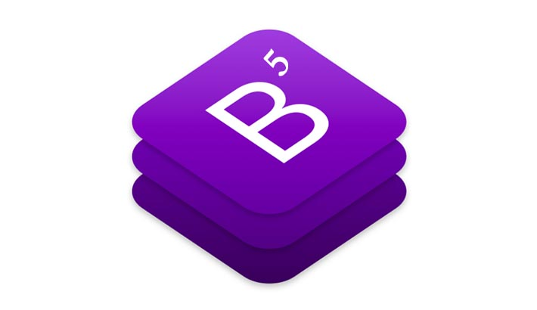
CSS stands for Cascading Style Sheets.
CSS describes how HTML elements are to be displayed on screen, paper, or in other media.
CSS saves a lot of work. It can control the layout of multiple web pages all at once.
External stylesheets are stored in CSS files.
BOOTSTRAP
Bootstrap is the most popular CSS Framework for developing responsive and mobile-first websites.
Bootstrap 5 is the newest version of Bootstrap
Bootstrap also provides the users with the ability to easily create responsive designs.
The responsive CSS of Bootstrap also adjusts to phones, tablets, and desktops easily.
It is compatible with all modern browsers like Chrome, Firefox, Internet Explorer, Edge, Safari, and Opera.

Slide 8


BACKEND REQUIREMENT
jQuery is a fast, small, and feature-rich JavaScriptlibrary.
It makes things like HTML document traversal and manipulation, event handling, animation, and Ajax much simpler with an easy-to-use API that works across a multitude of browsers.
With a combination of versatility and extensibility, jQuery has changed the way that millions of people write JavaScript.
PHP is an acronym for "PHP: Hypertext Preprocessor“.
PHP is a widely-used, open source scripting language.
PHP scripts are executed on the server.
PHP can generate dynamic page content
PHP can create, open, read, write, delete, and close files on the server
PHP can send and receive cookies
PHP can add, delete, modify data in your database
PHP can be used to control user-access.
PHP can encrypt data.

Slide 9
FLOW CHART
Start
Input
F
F
Input validation
T
Matching Credential
T
Operations(Insert,Delete etc.)
T
End

Slide 10
ADVANTAGES
User can access database from any device.
User interaction increase with simple UI.
User can take backup of database.

Slide 11
Conclusion
It is a web application software that runs in a web browser with an active network connection.
User can access database from any device because it work independently and are not affected by the platform.
Easy to use.
User can take backup of database easily.

Slide 12
THANK YOU

